Slide 1
Final Year Project HazPak E-Learning Portal
Kay Zin Htet, Sim Yu Bo, Yong Sean, Puah Yu Hao Louis

Slide 2
Table of contents
Team Introduction and roles
Project Introduction
Project Timeline
Project Summary & Explanation
Team Members Contribution

Slide 3
Team Introduction and roles
Puah Yu Hao Louis(Front-end Developer/Back-end Development)
Kay (Front-end Developer)
Yu Bo (Back-end Developer)
Yong Sean(Back-end Developer)

Slide 4
Project Introduction
HazPak confronted a significant hurdle with their manual and non-interactive exercise and assessment methods. These approaches failed to engage trainees effectively, impeding learning and posing challenges for instructors in terms of evaluation. The lack of interactivity also made HazPak less competitive in a technology-driven training landscape. To overcome this, the project aimed to create an online platform that modernizes training, making it engaging and efficient for both learners and instructors.

Slide 5
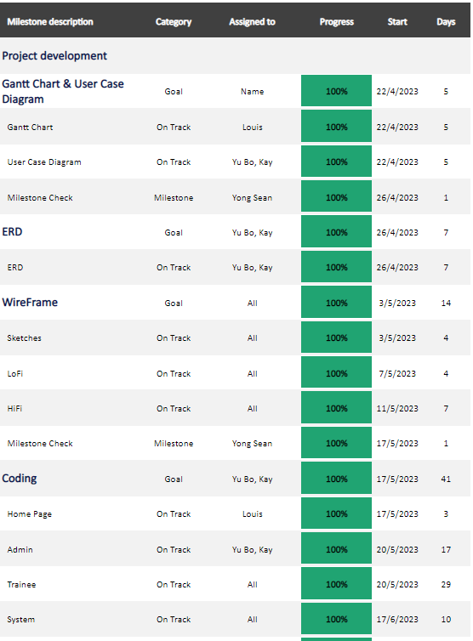
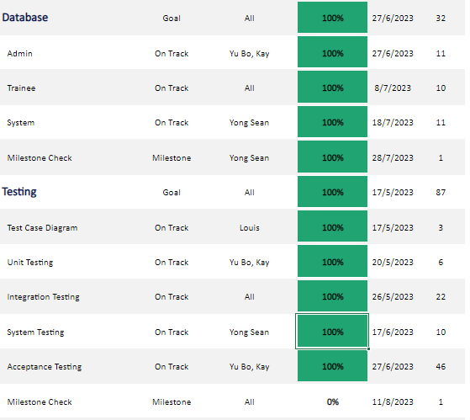
Project Timeline

Slide 6
Project Summary and Explanation
Our project goal is to design an E-learning website portal
Admins
Create, Update, and Remove assessment/exercise/trainee
Trainee
Perform online exercise/assessment
System
Recognize user upon login
Record trainee assessment scores
Contain user's details

Slide 7

Team Members Contribution

Slide 8
Kay
Did the entire grades page
Completed the add, edit and view trainee function in courses page
Completed the add courses function
Did some of the front-end work for both admin side and trainee side

Slide 9
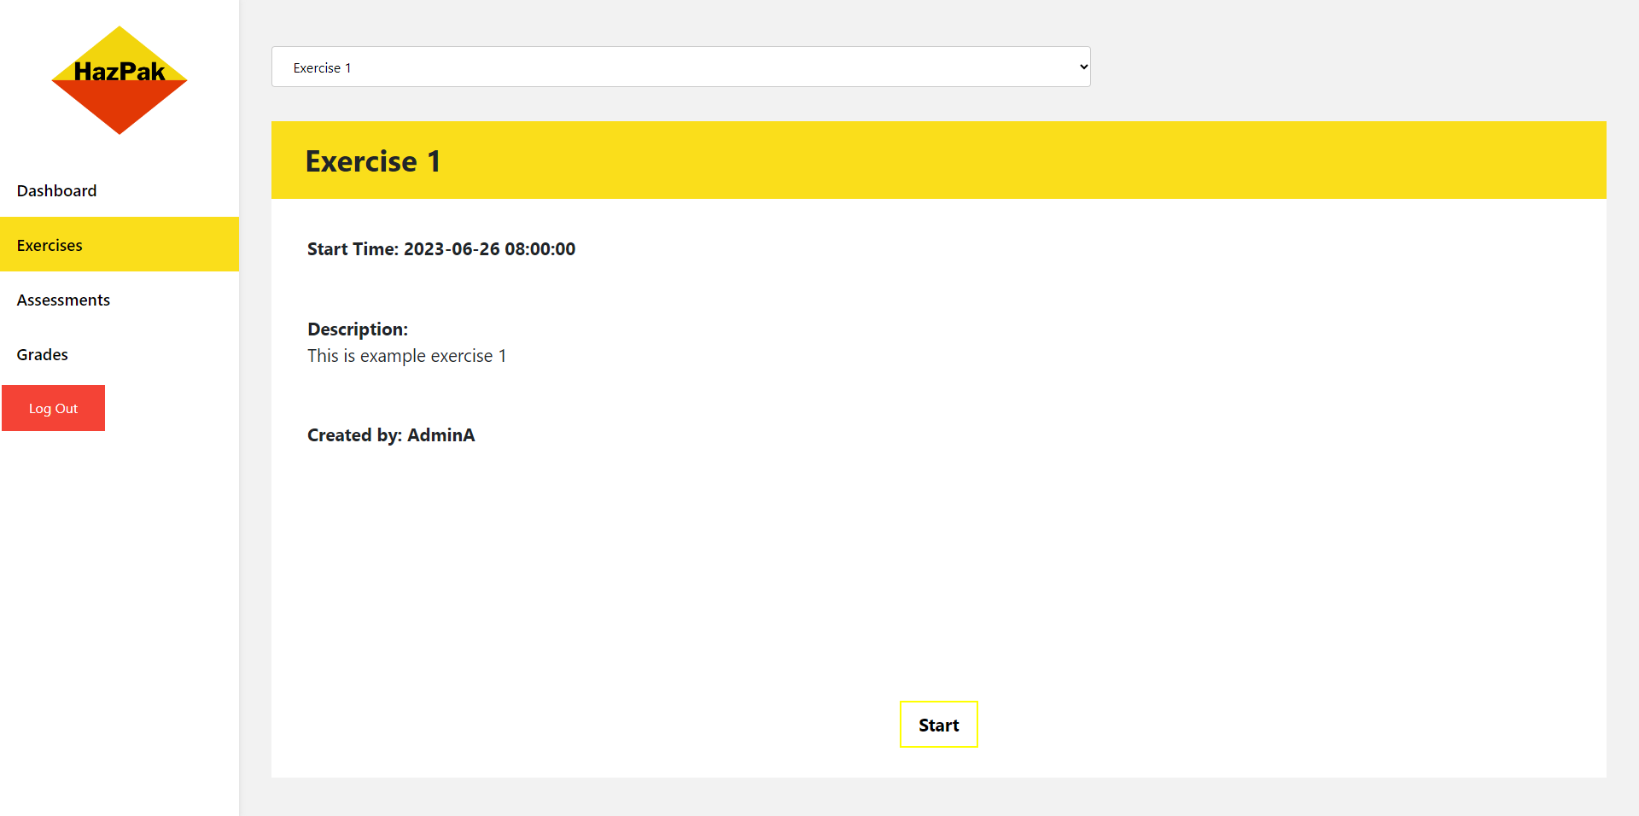
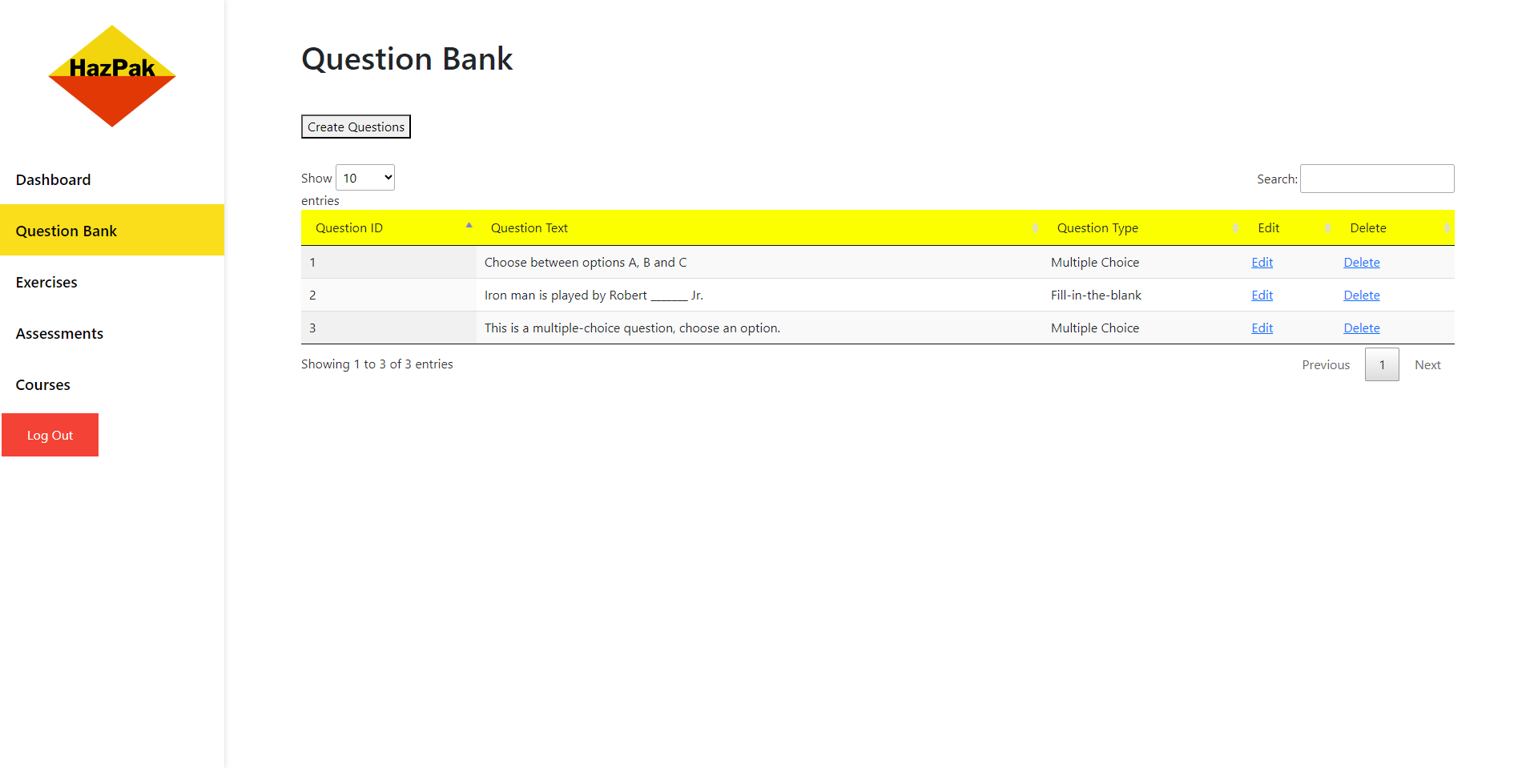
Yu Bo's Contribution
Question bank
Able to create, edit and delete questions
2 question types, Multiple-Choice, and Fill-in-the-blanks
Side navigation bar
Created reusable navbar and auto update navigation items for different user roles
Data table structure
Created basic structure for the tables to be reused
Assessment & Exercise Details
Created page to allow user to select assessments/exercises available
Allows trainees to see information of assessments/exercises

Slide 10
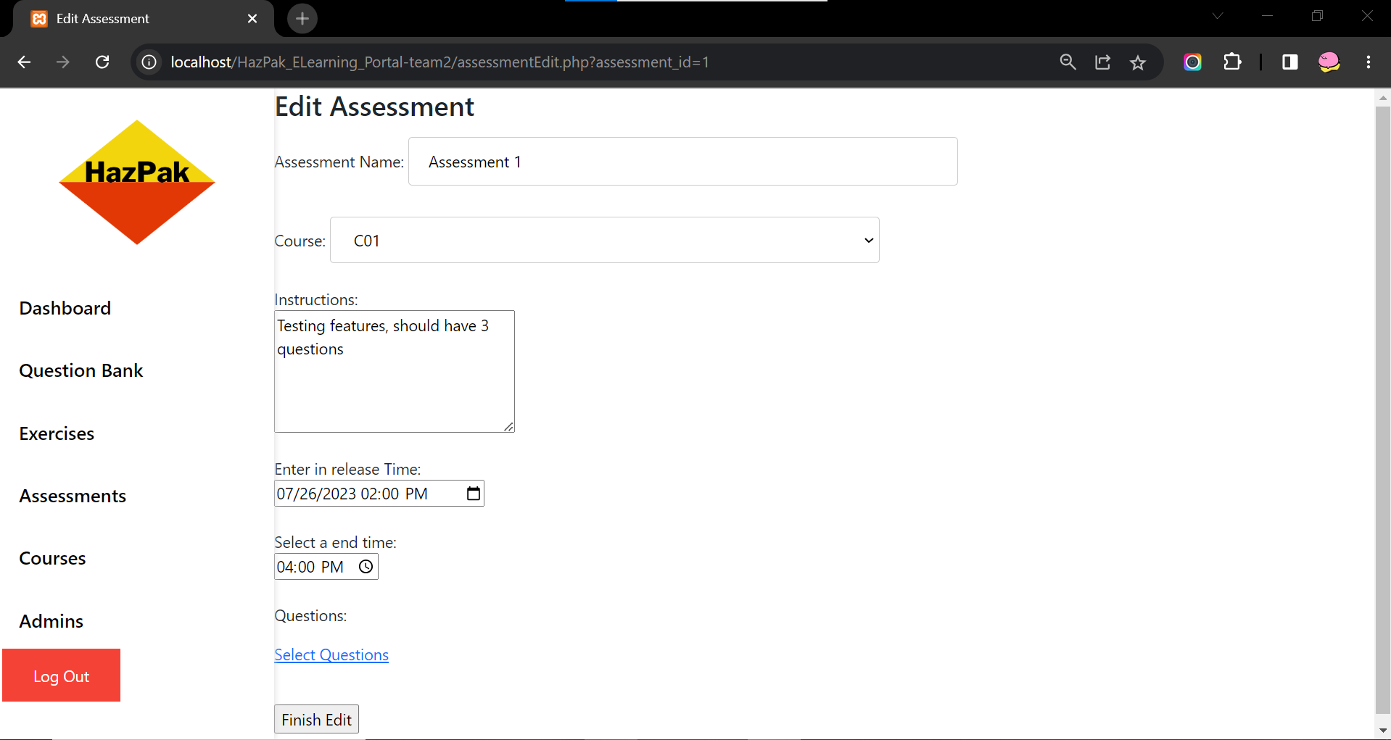
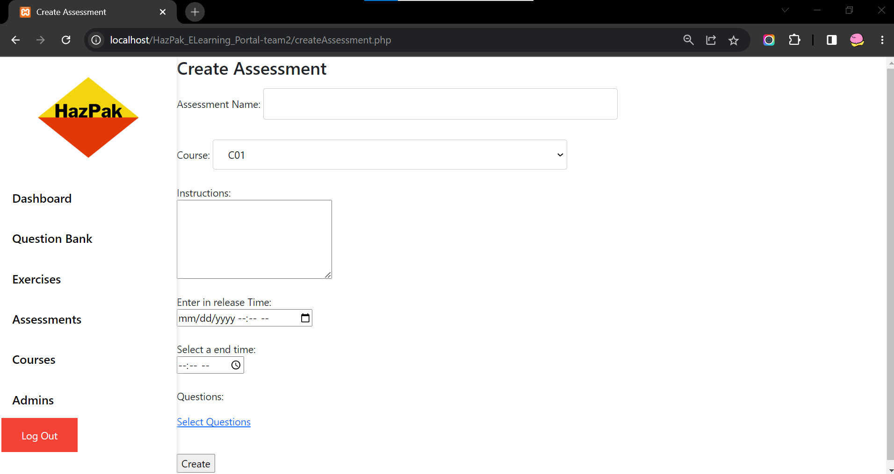
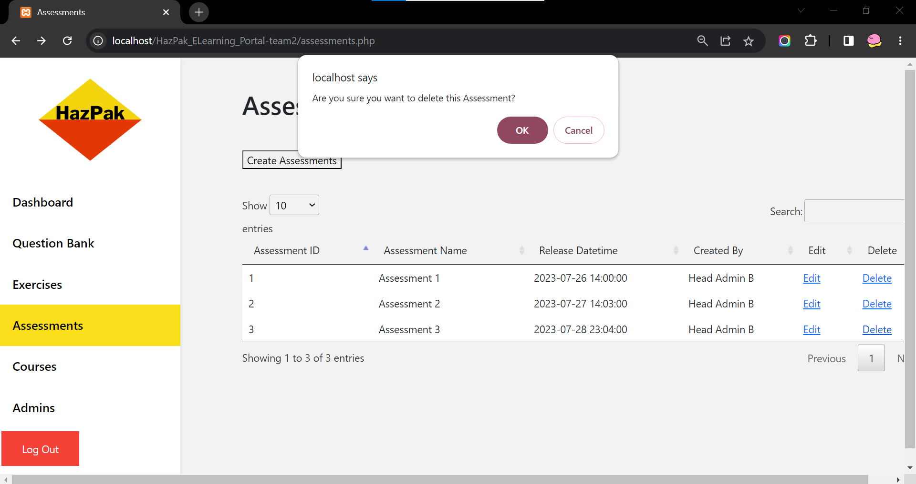
Sean's Contributions
Back-end coding
Minor contribution for question Bank
Coded feature where trainee login first time is prompted to change their password
Coded admin's create, edit, and delete feature for assessments and exercises
Coded Head admin create, edit, and delete admin feature

Slide 11
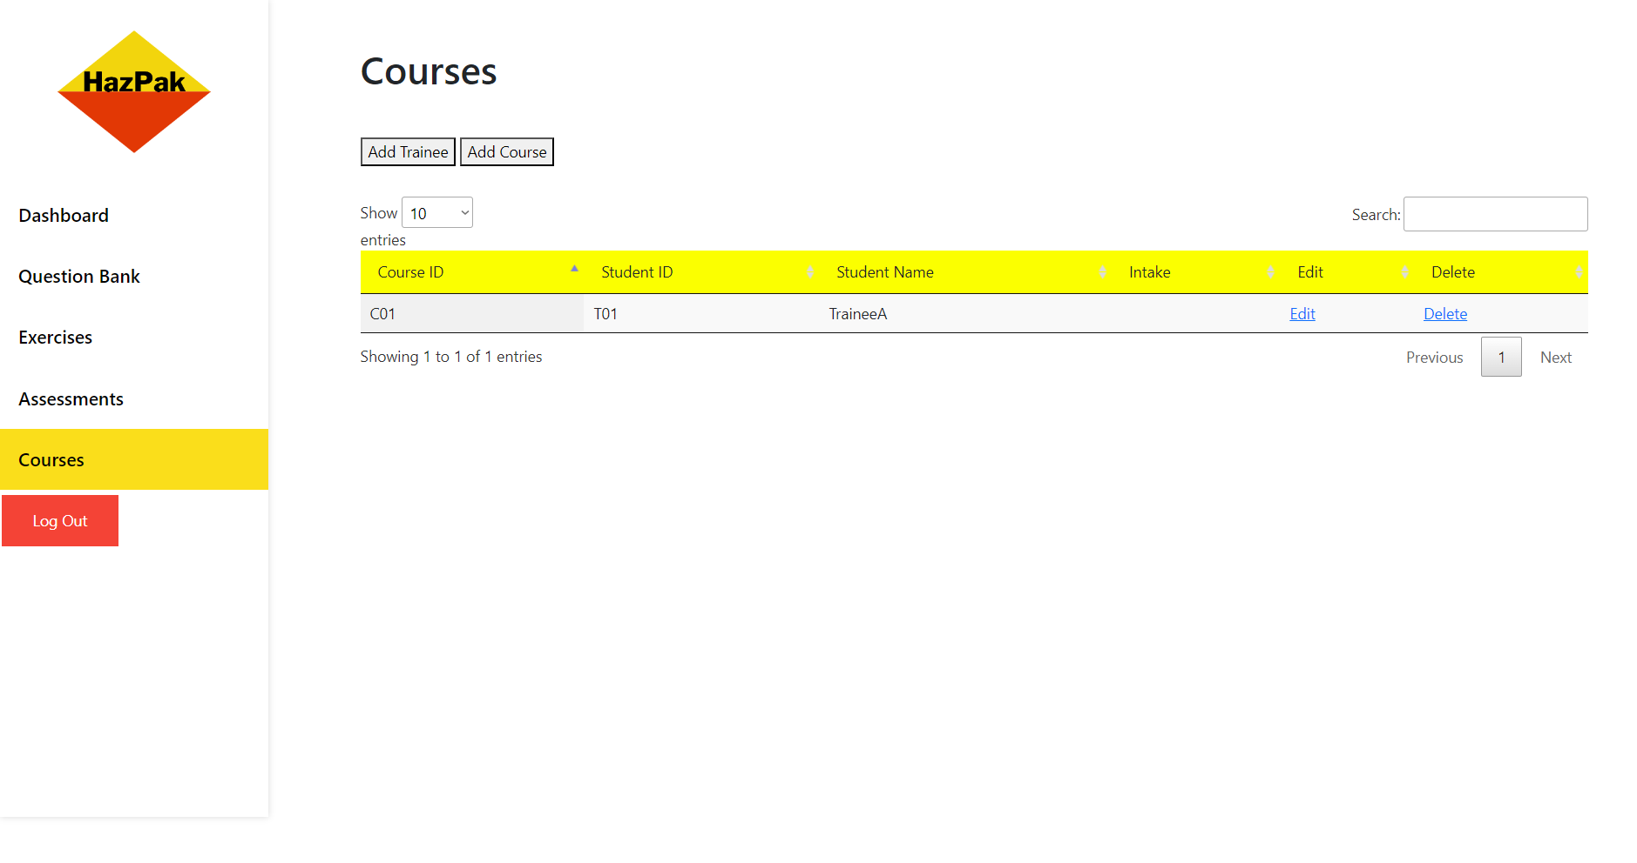
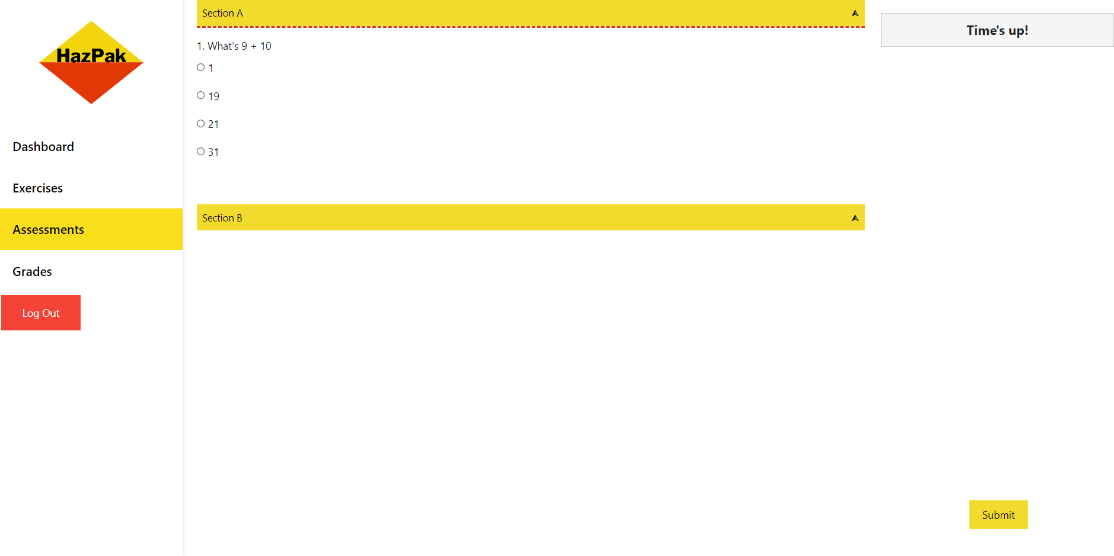
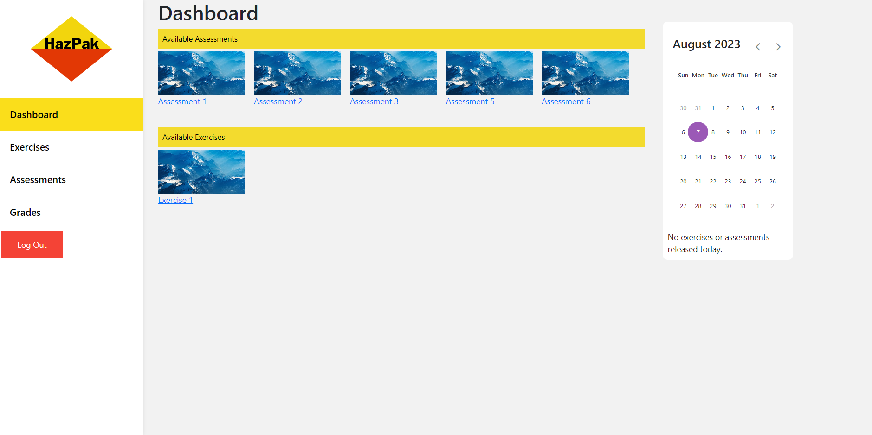
Louis Contributions
Front-end Coding
Created layouts of each page
Added features such as collapsiable, countdown timer and calandar
Added stylesheet code for easier formating and design preferences
Back-end Coding
Linked pages such as grades.php, takeAssessment.php, takeExercise.php, submit_assessment.php, submit_exercise.php
Created code to POST test results of assessments and exercises to assessment_grade & exercise grades datatables respectively
Created deleteTrainee.php
Displayed released assessments and exercises in Dashboard page

